Slide 1


Minimizing CPU Utilization for Deep Networks
August 8, 2019
Sheraton Grand
Akshay Bahadur

Slide 2
Acknowledgement

Slide 3



Akshay Bahadur
SDE – Symantec
Intel Software Innovator
Google Developer Expert
(Machine Learning)

Slide 4
Agenda
Blah
More Blah
Blah Blah…
Thank you

Slide 5
Agenda
Normalization
Optimizers
Activation
Advanced Activation
Focal Loss instead categorical loss
Learning Rate Decay with Adam
Network Architecture optimization
Autopilot research paper by NVIDIA
Handling out of memory issue
Scaling Images
Adding filters and Splitting channels
Fit Generator
Emojinator
Image Augmentation
DeepSign

Slide 6
Tania’s Story

Slide 7
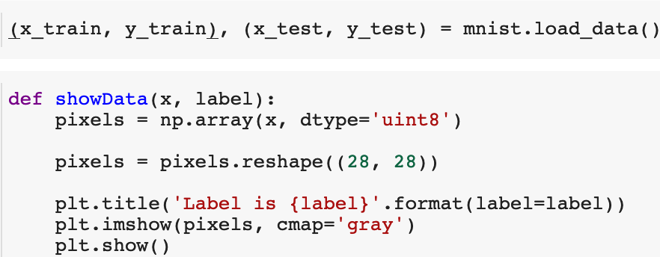
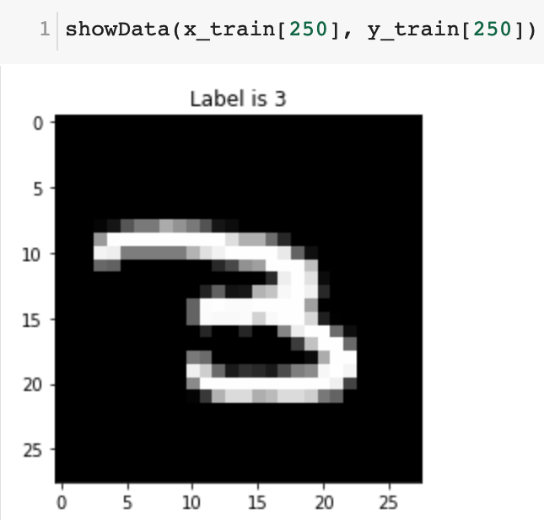
Normalization
Normalization is a technique often applied as part of data preparation for machine learning. The goal of normalization is to change the values of numeric columns in the dataset to a common scale, without distorting differences in the ranges of values.

Slide 8
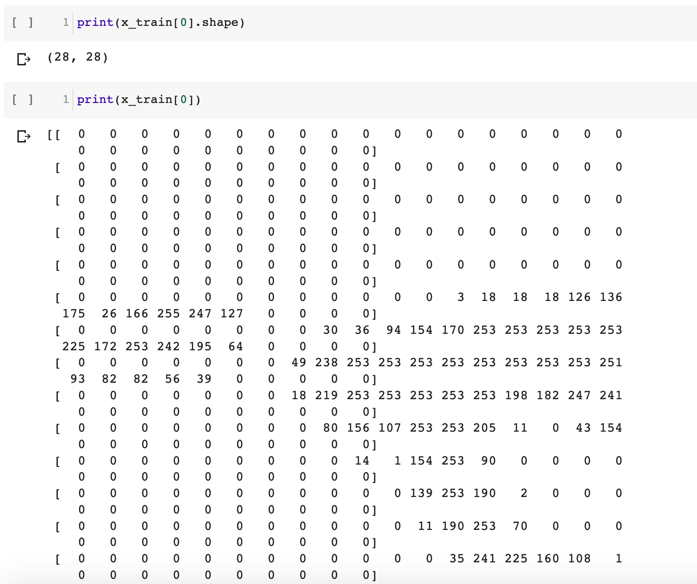

Slide 9
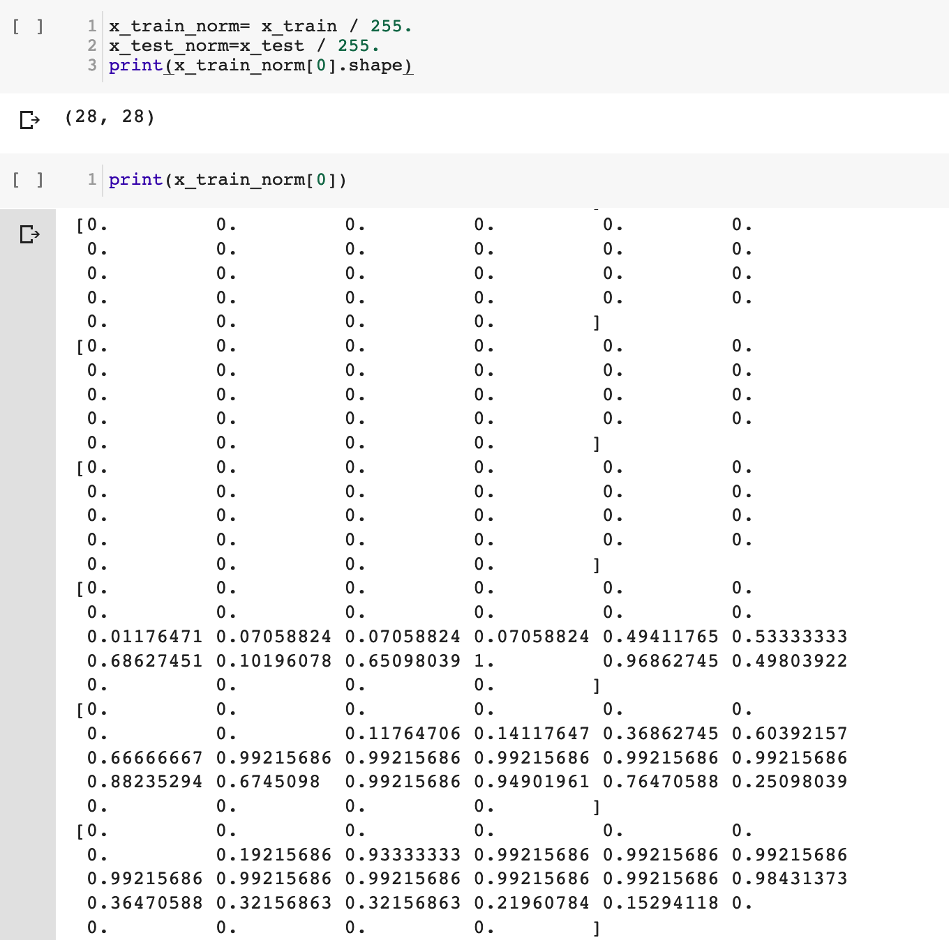

Slide 10
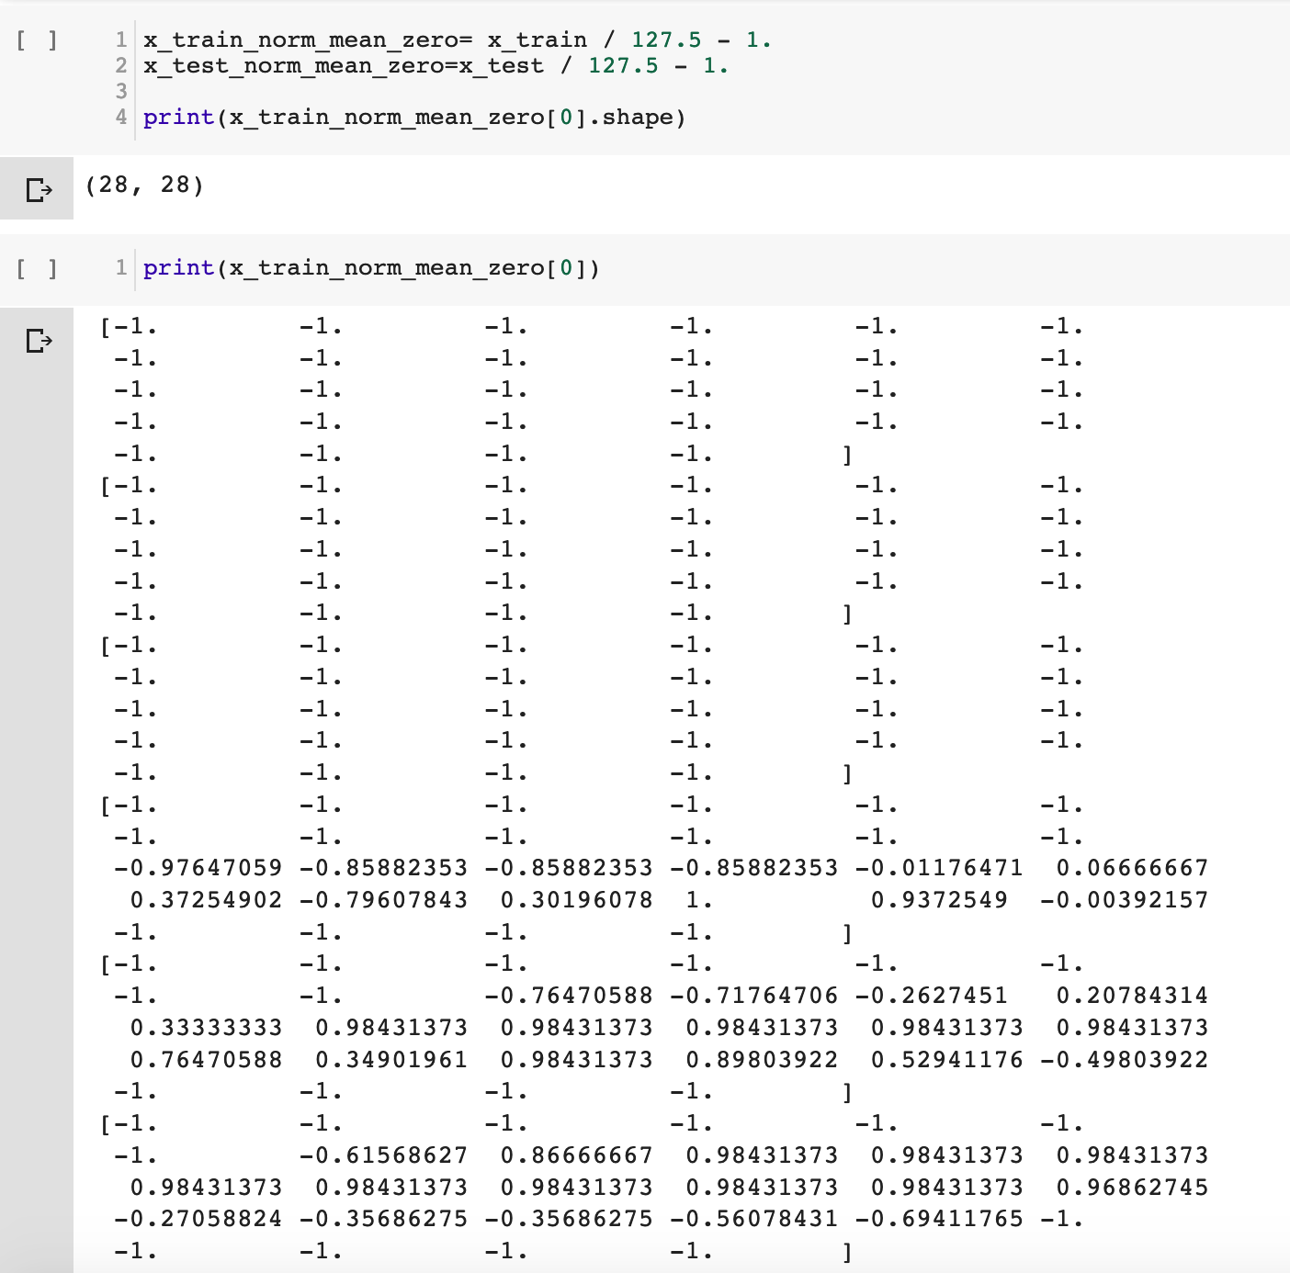

Slide 11
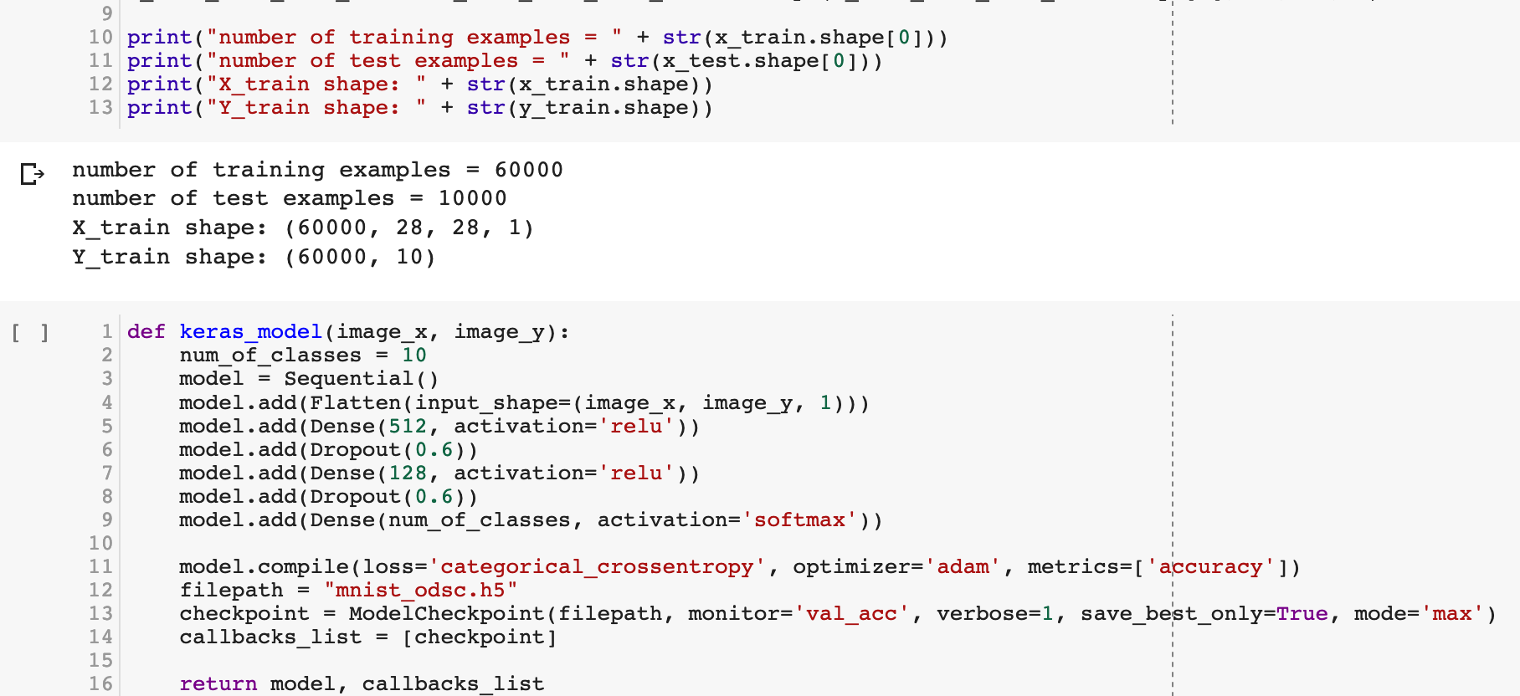

Slide 12
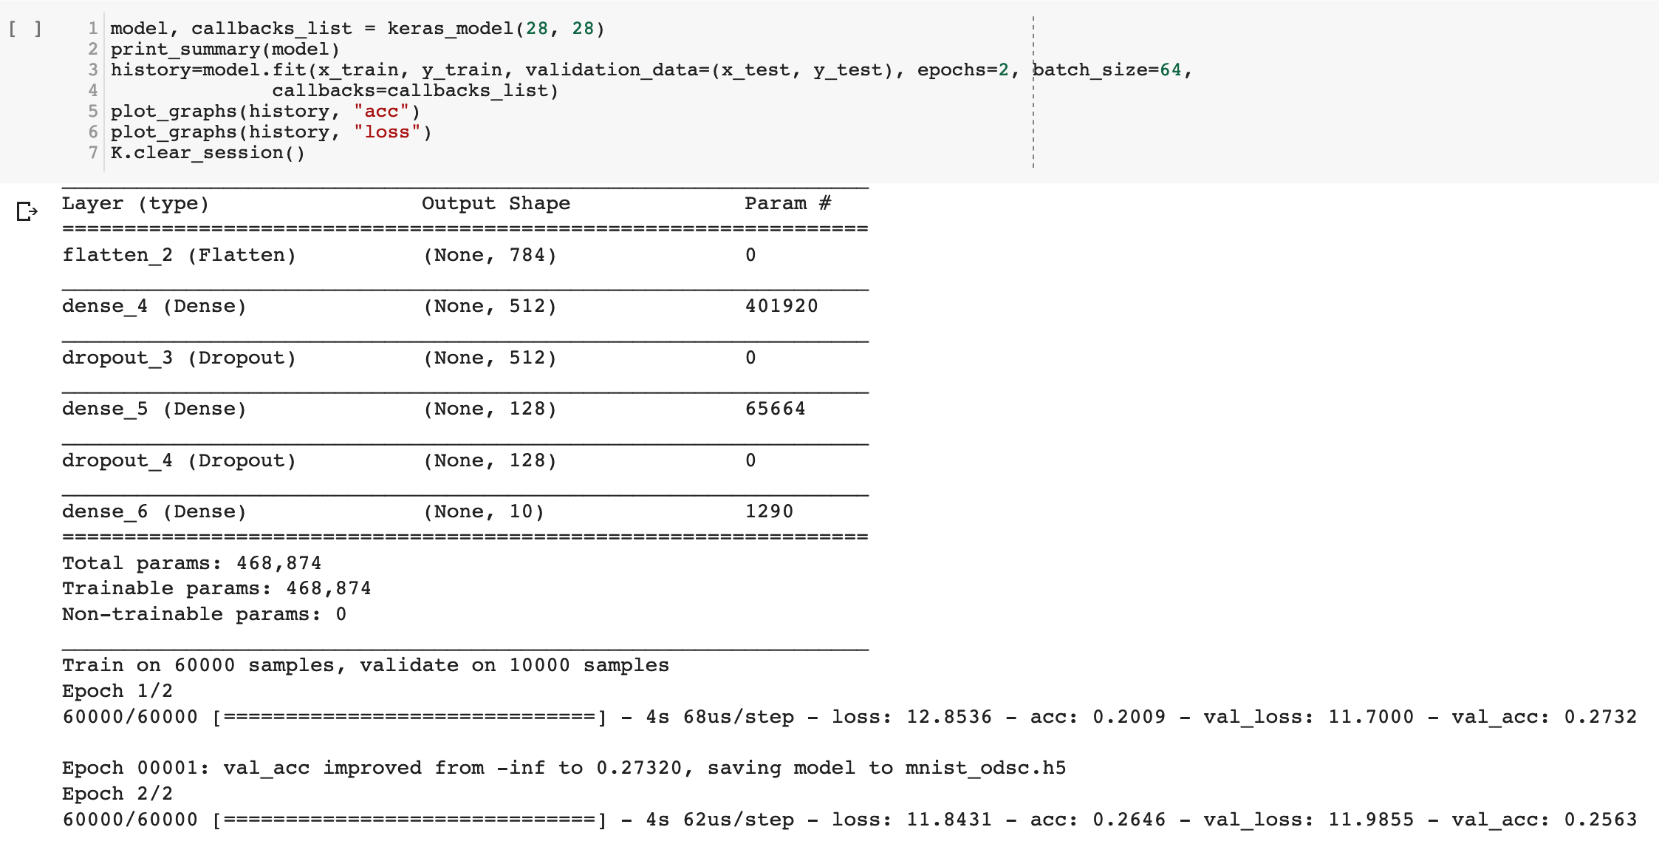

Slide 13
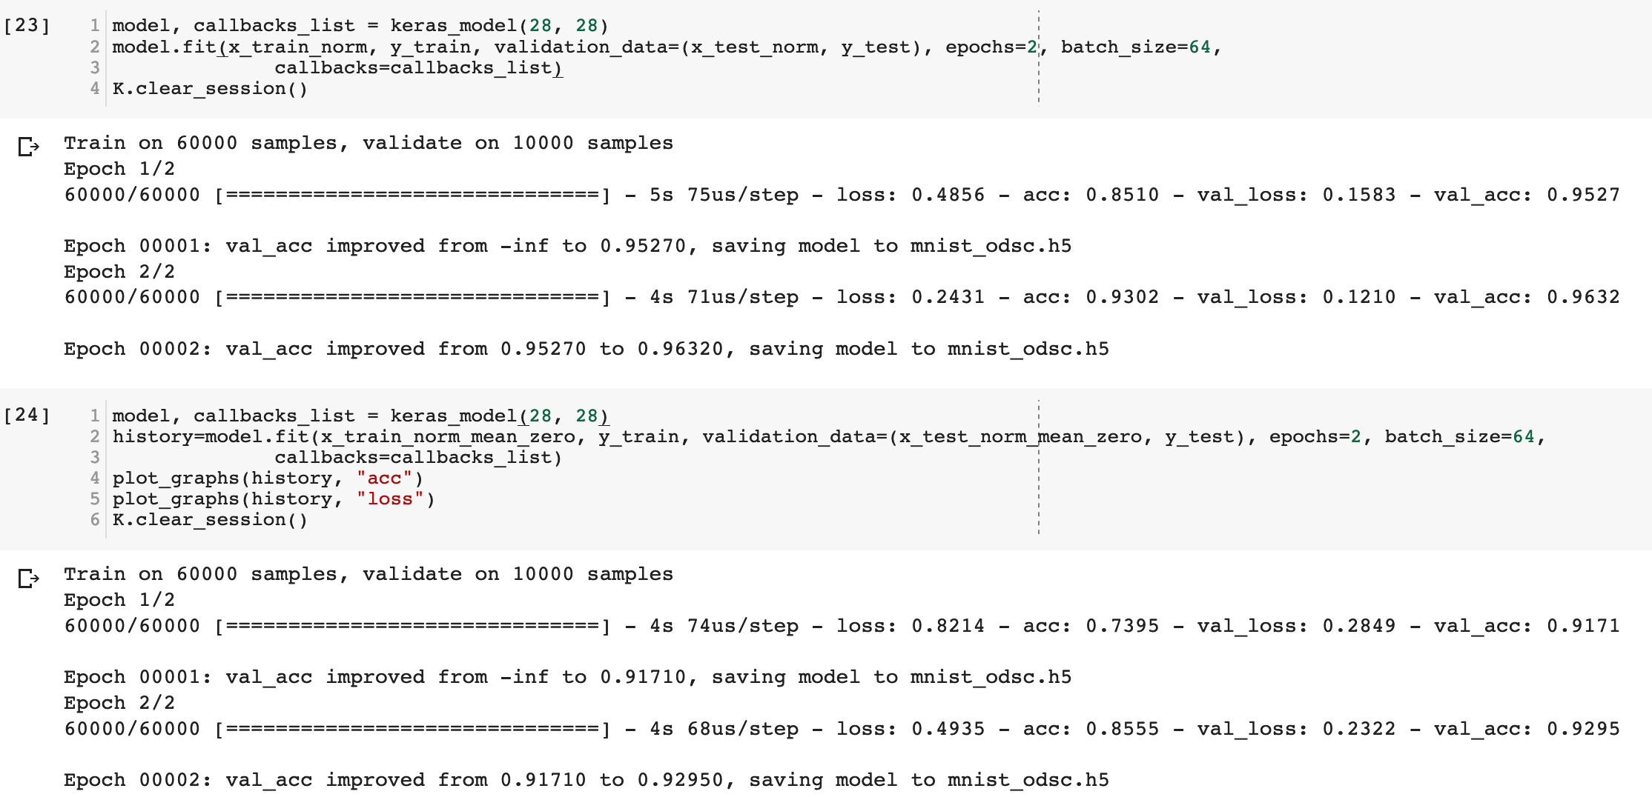

Slide 14
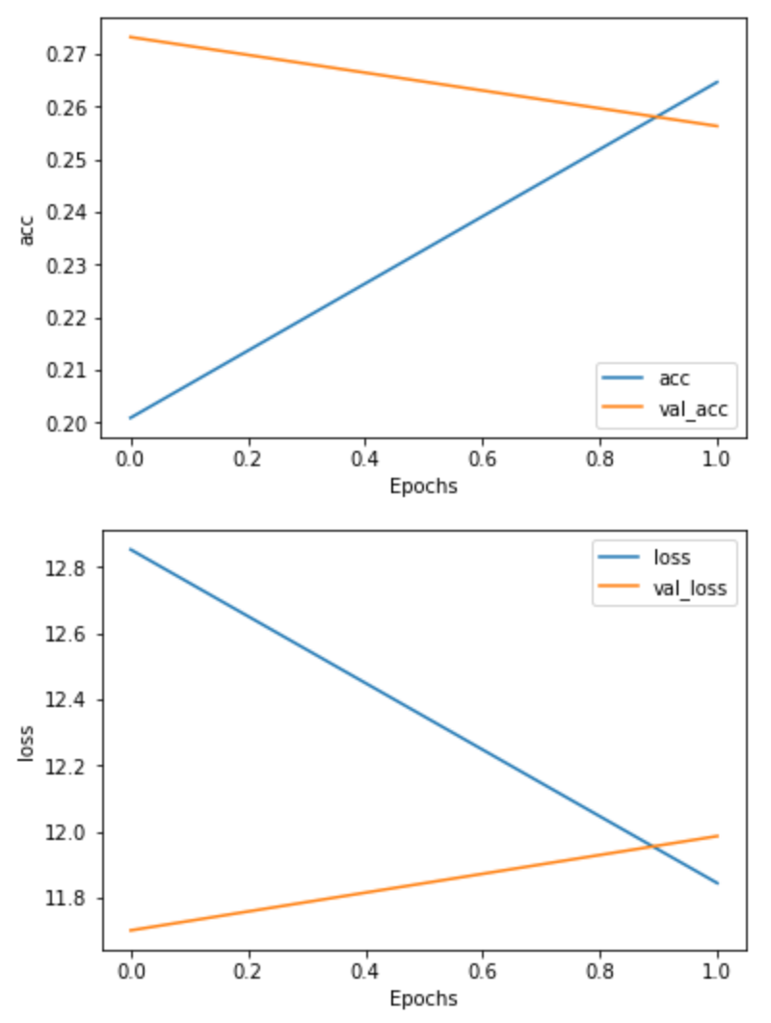
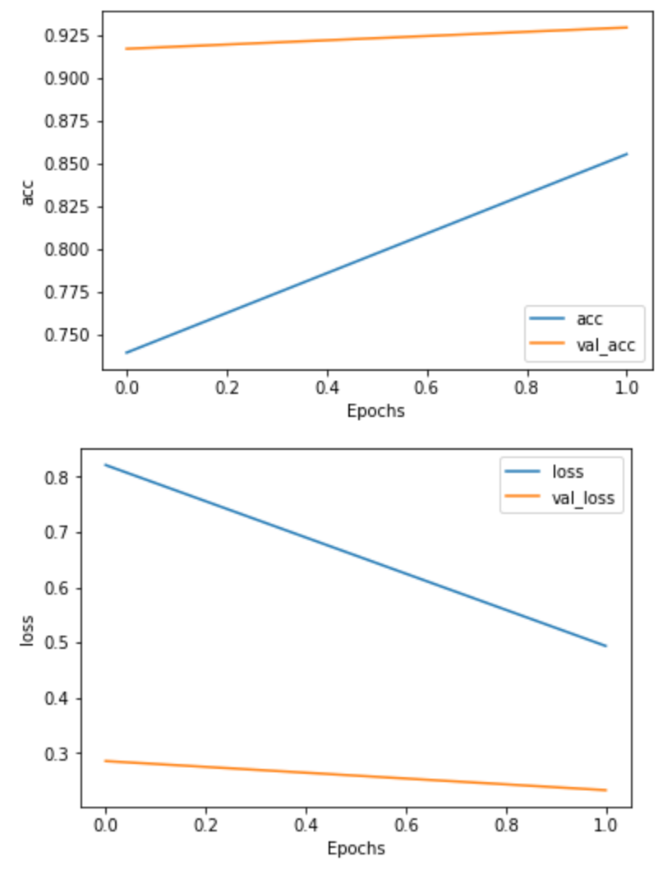

Slide 15
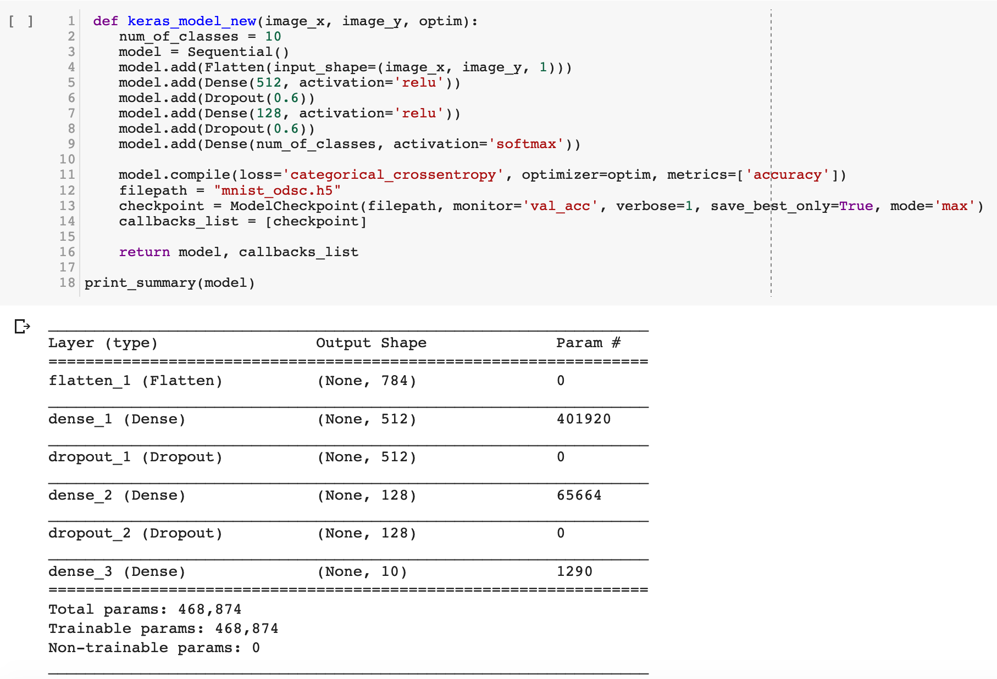
Optimizers

Slide 16
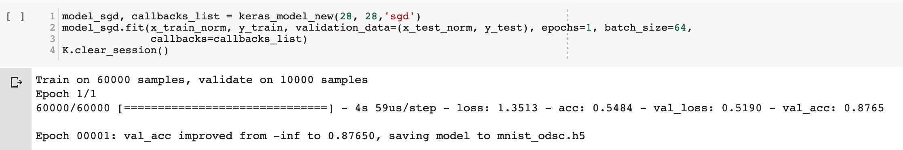
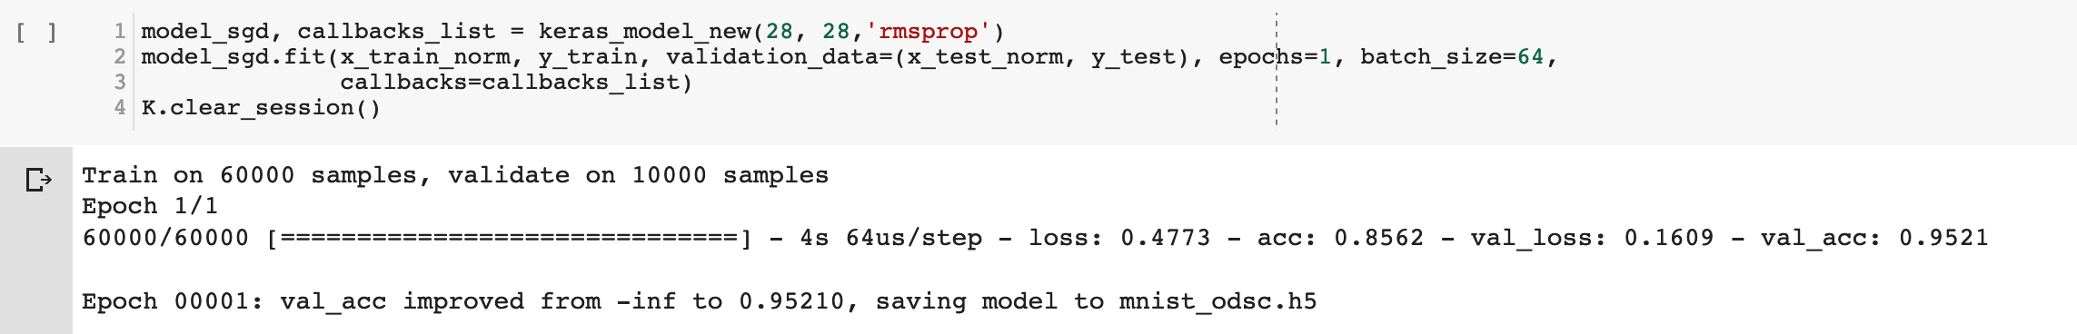
Stochastic Gradient Descent
RMSprop
Notes:
RMSprop

Slide 17
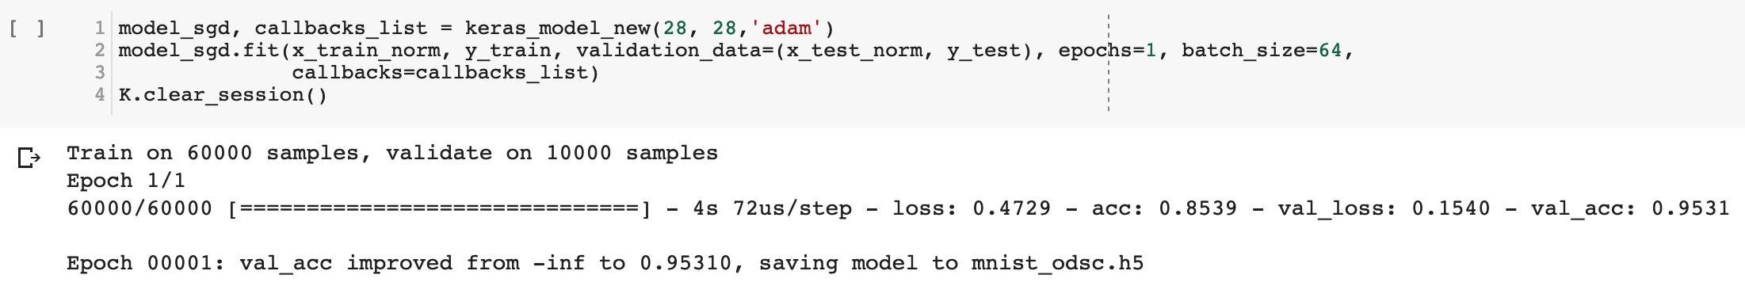
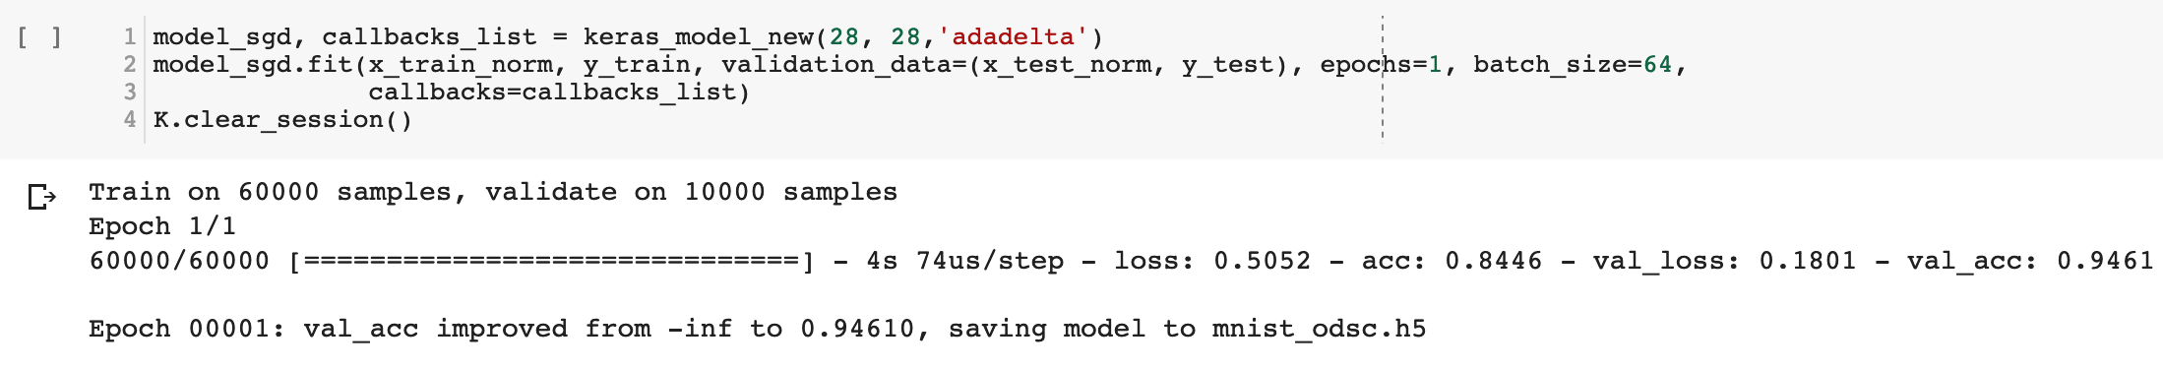
ADAM
AdaDelta
Notes:
RMSprop

Slide 18
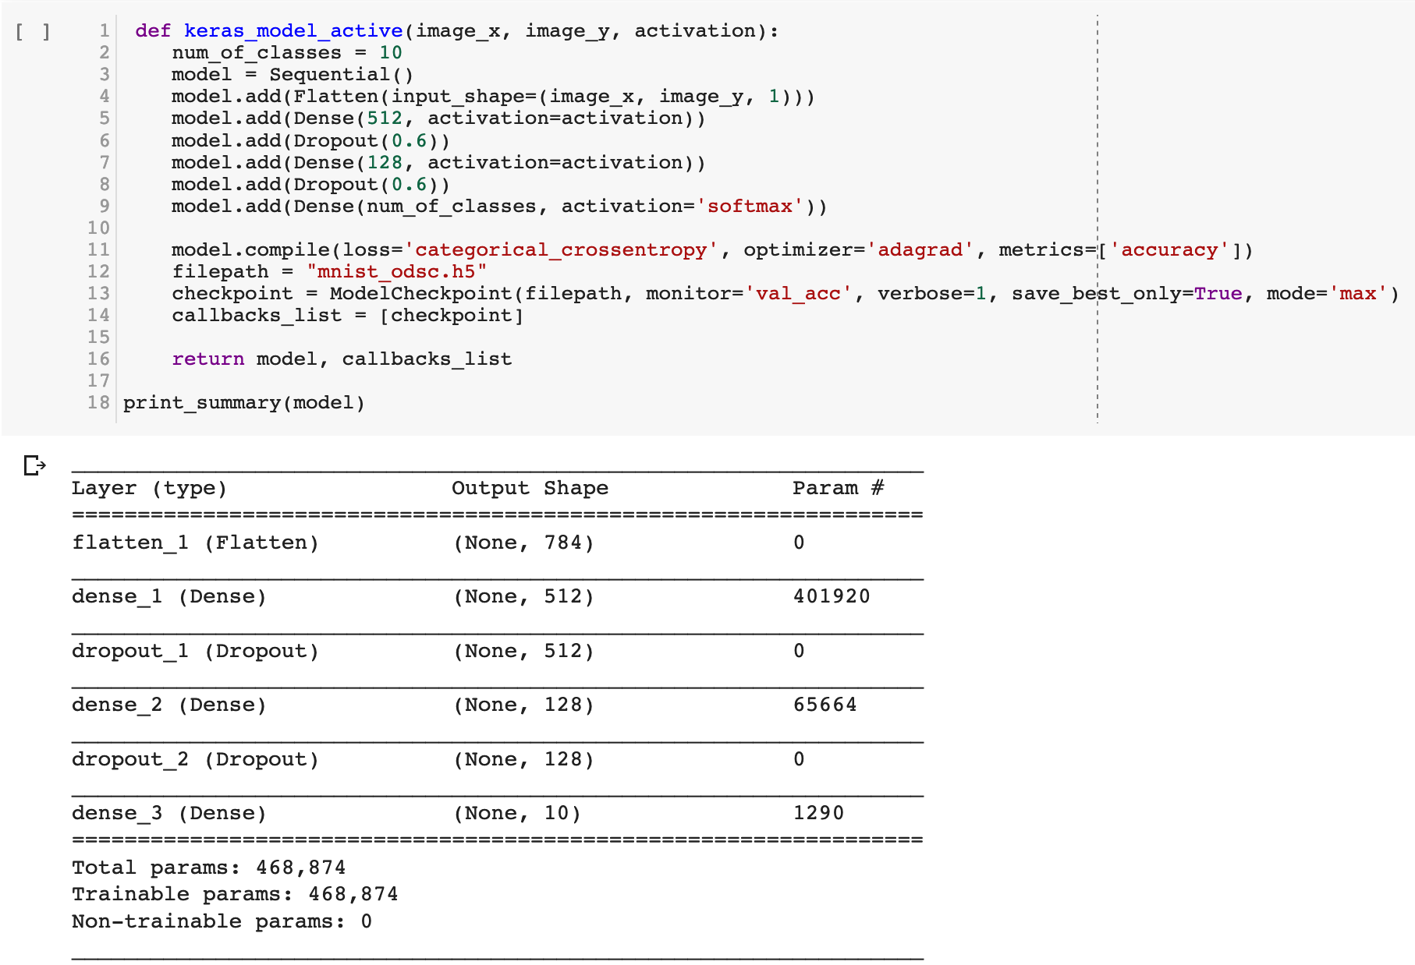
Activation

Slide 19
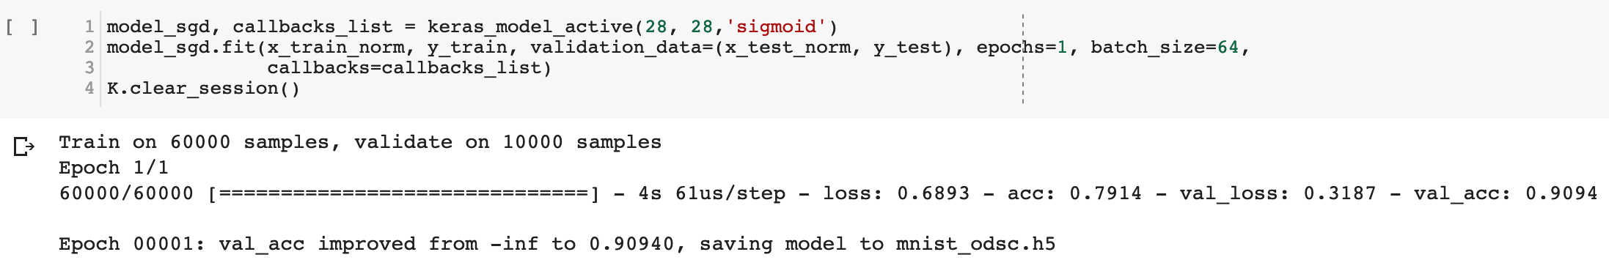
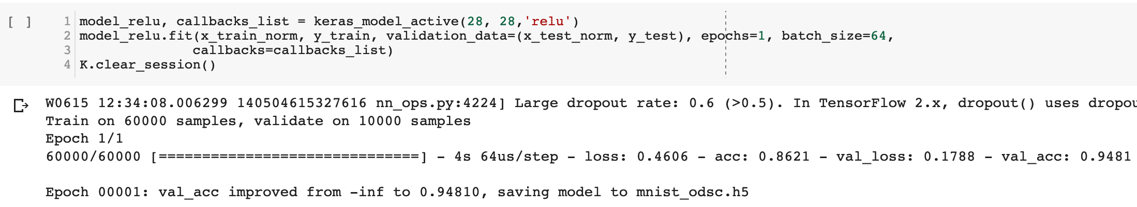
Sigmoid
Rectified Linear Unit
Notes:
RMSprop

Slide 20
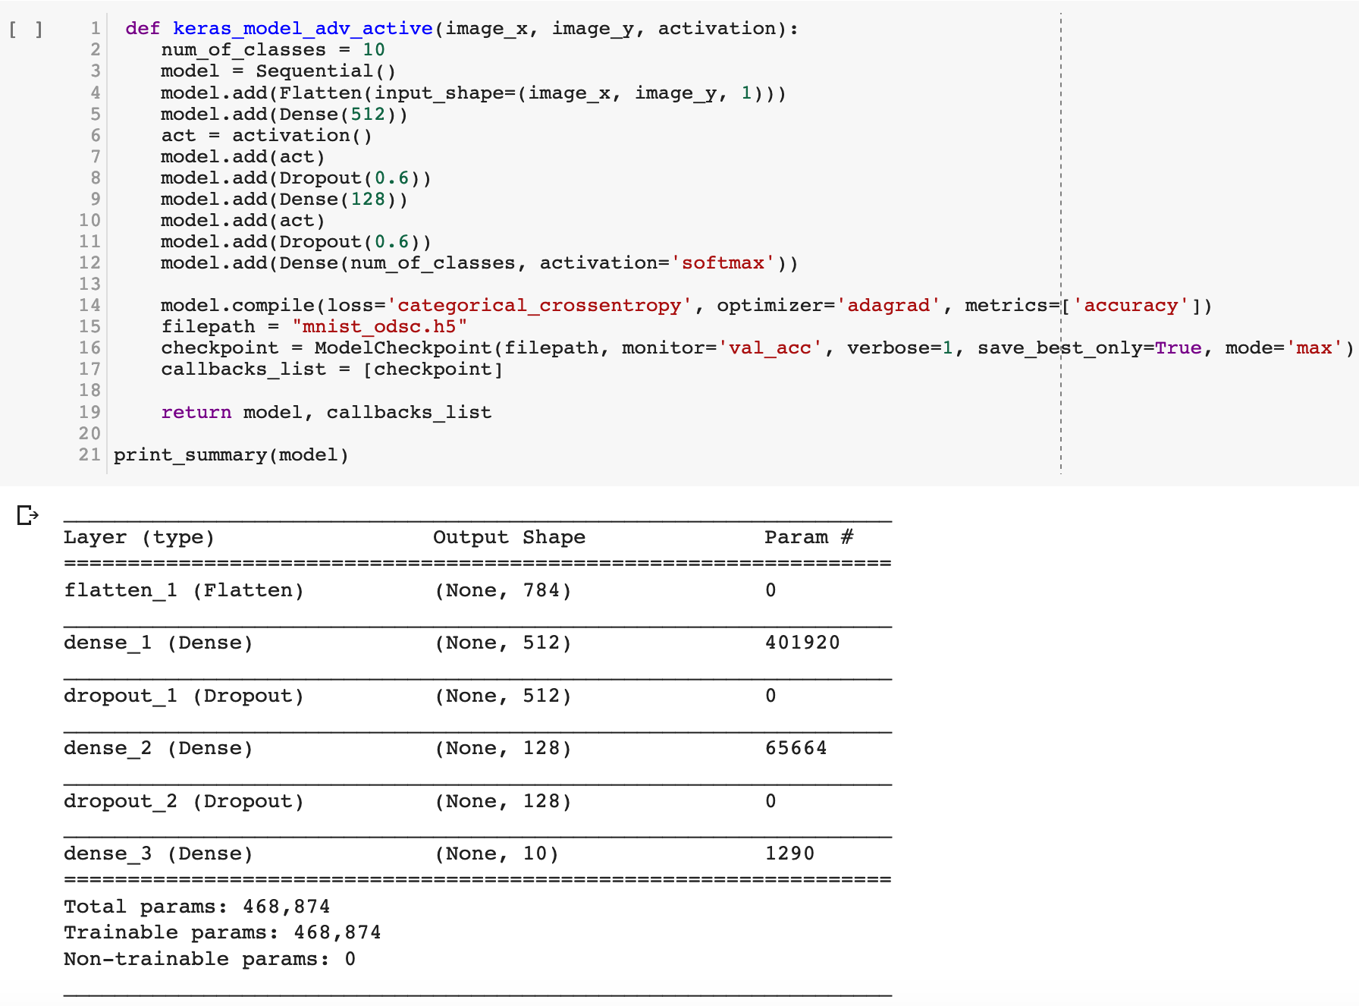
Advanced Activation

Slide 21
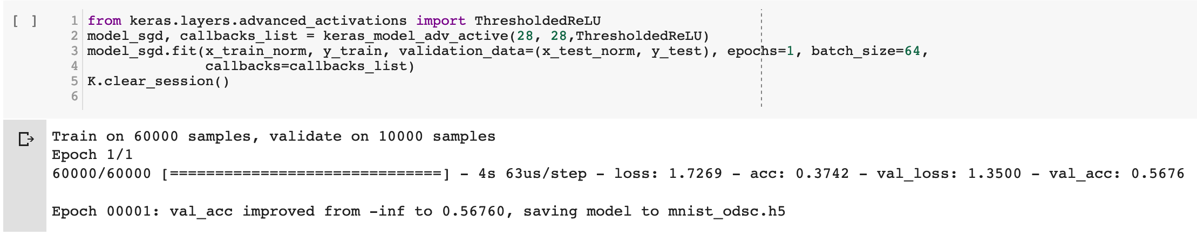
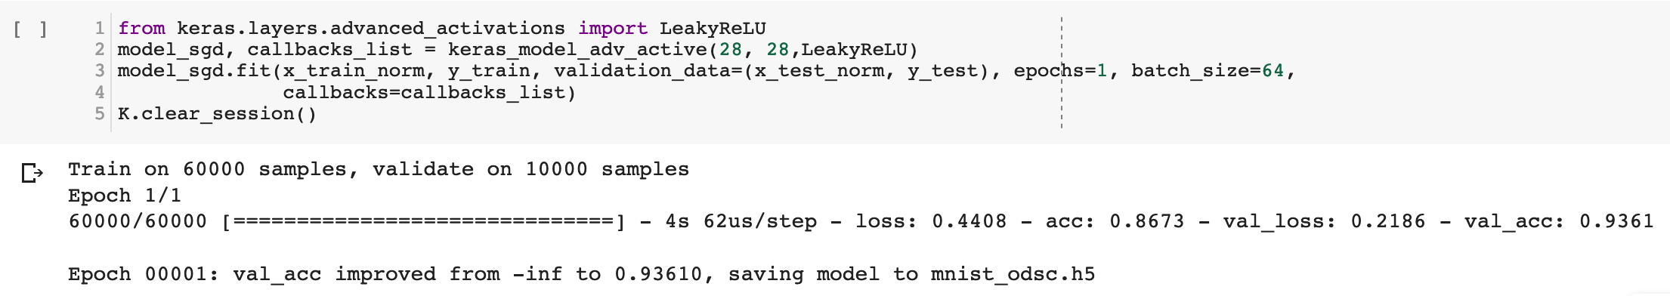
Thresholded ReLU
Leaky ReLU
Notes:
RMSprop

Slide 22
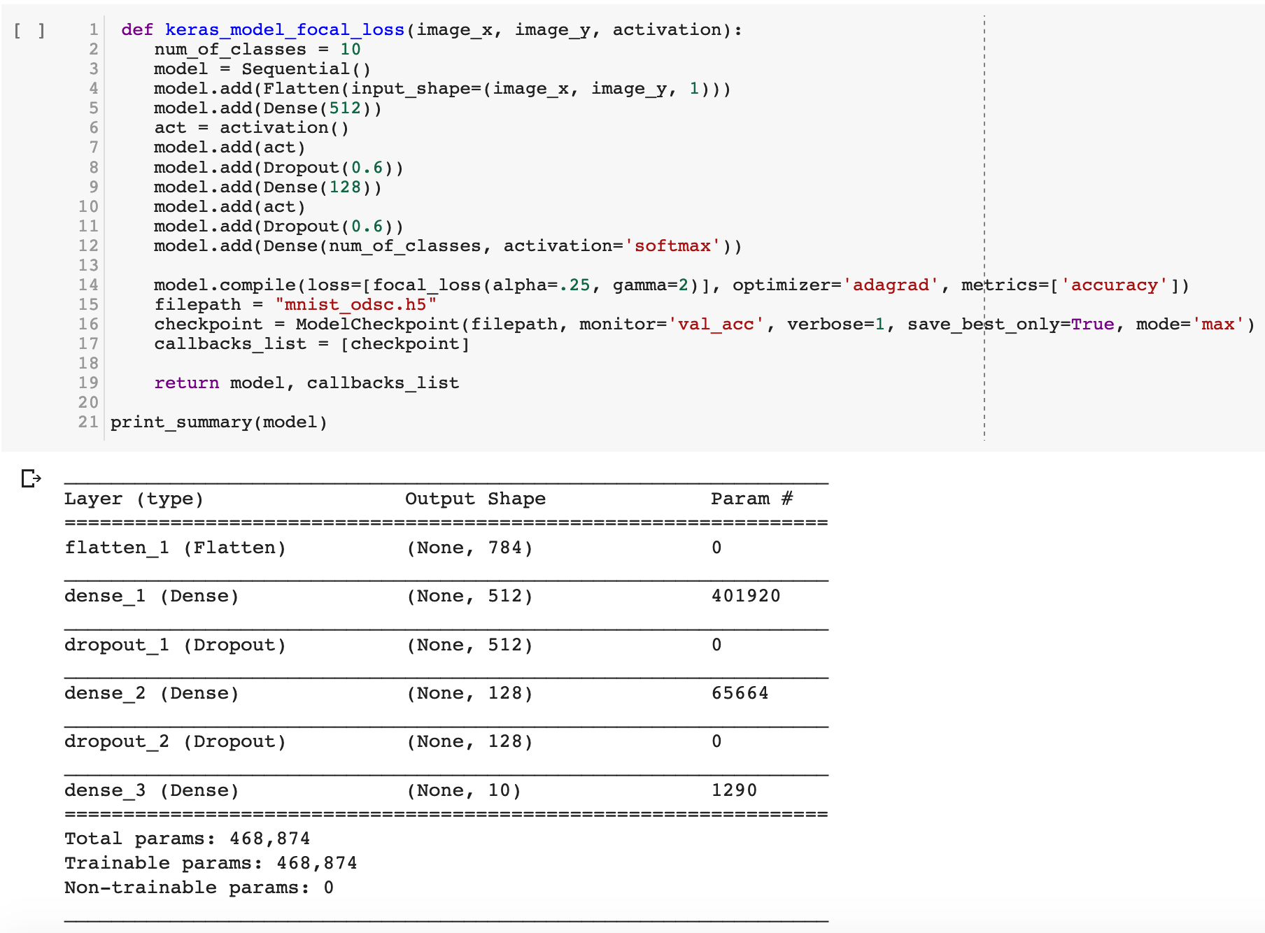
Focal Loss instead of categorical loss

Slide 23
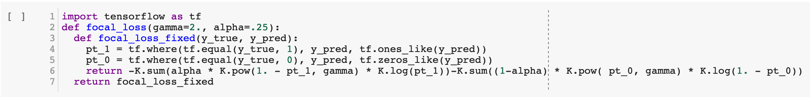
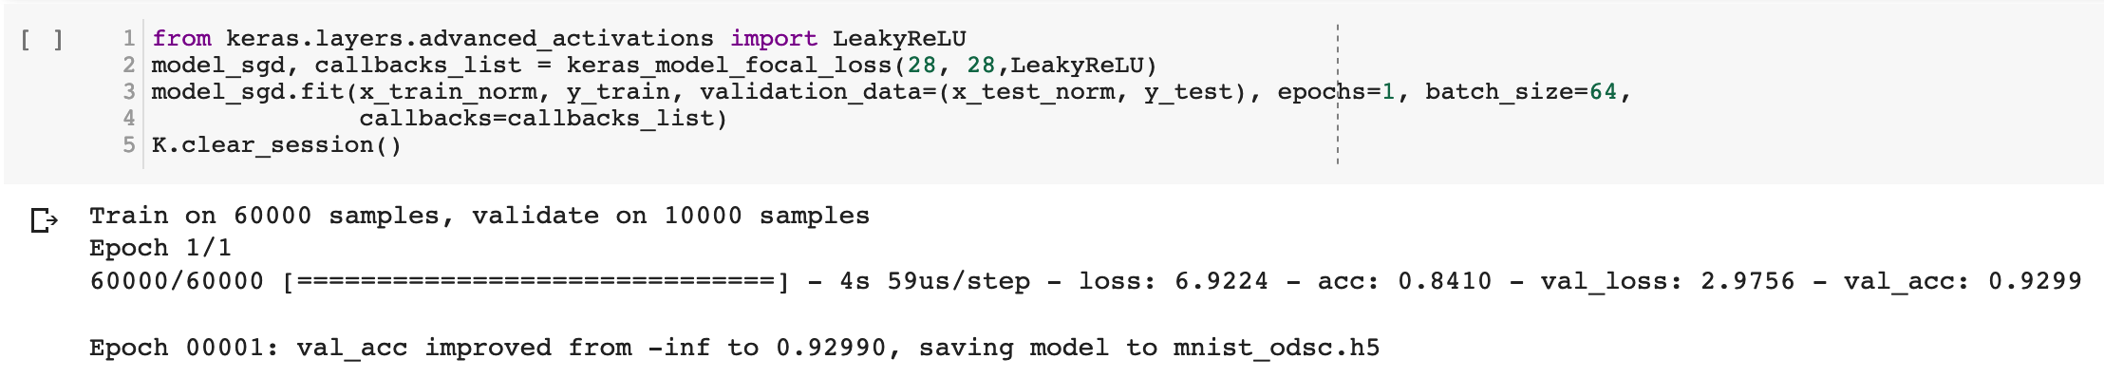
Focal Loss
Notes:
RMSprop

Slide 24
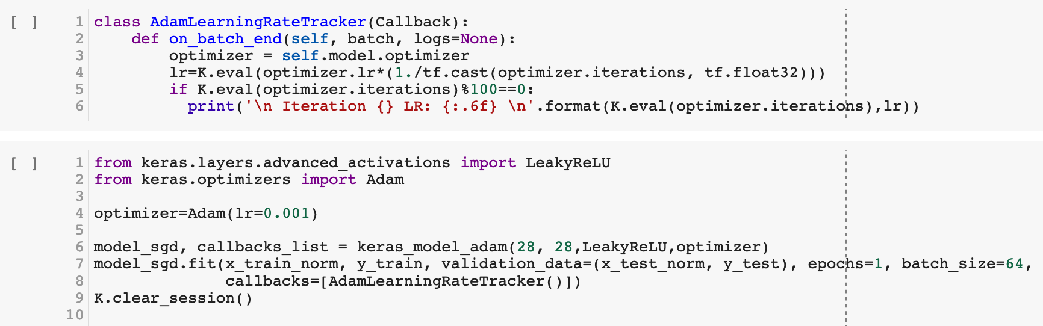
Learning Rate Decay with Adam

Slide 25
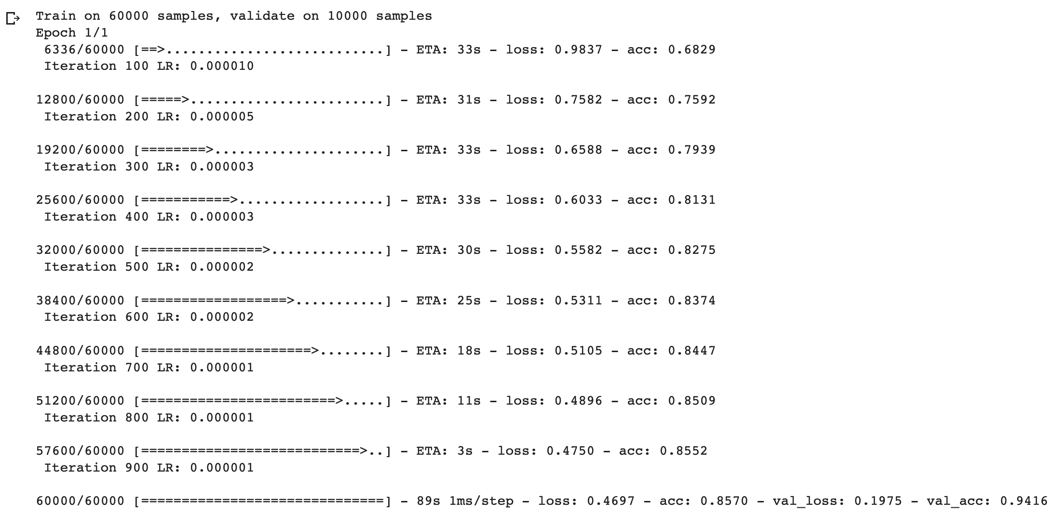

Slide 26
EMNIST

Slide 27
DigiEncoder

Slide 28
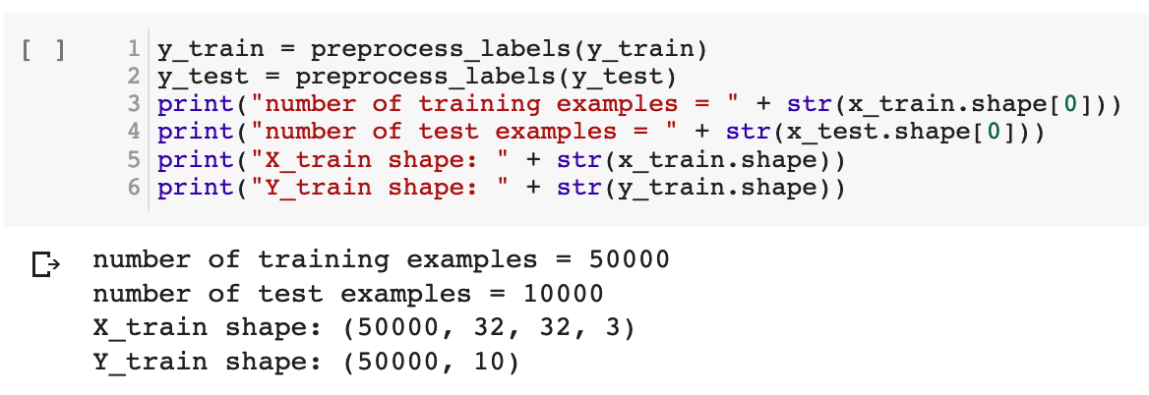
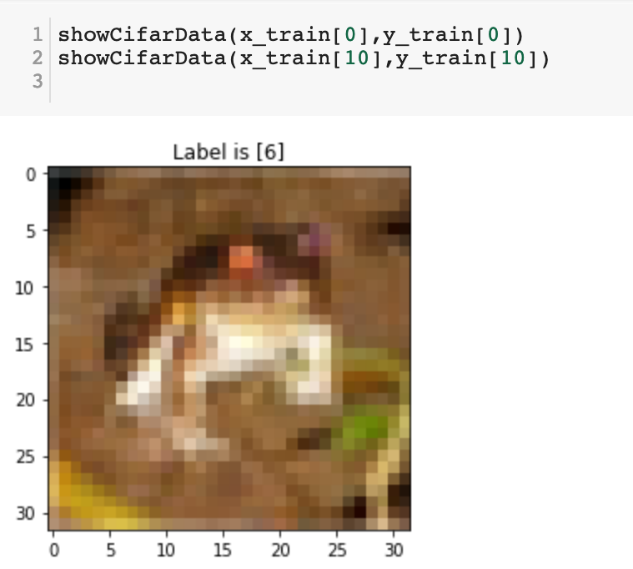
Network Architecture Optimization
Cifar 10

Slide 29
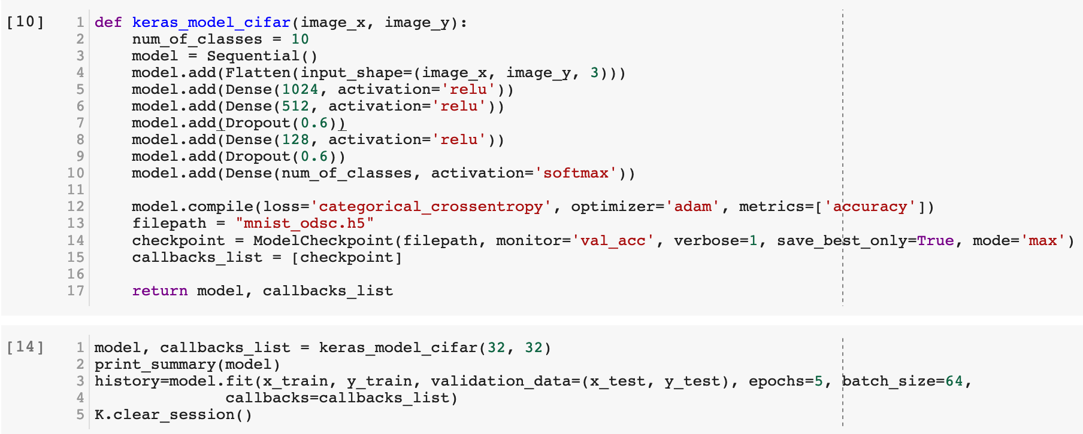
FC Architecture
Notes:
RMSprop

Slide 30
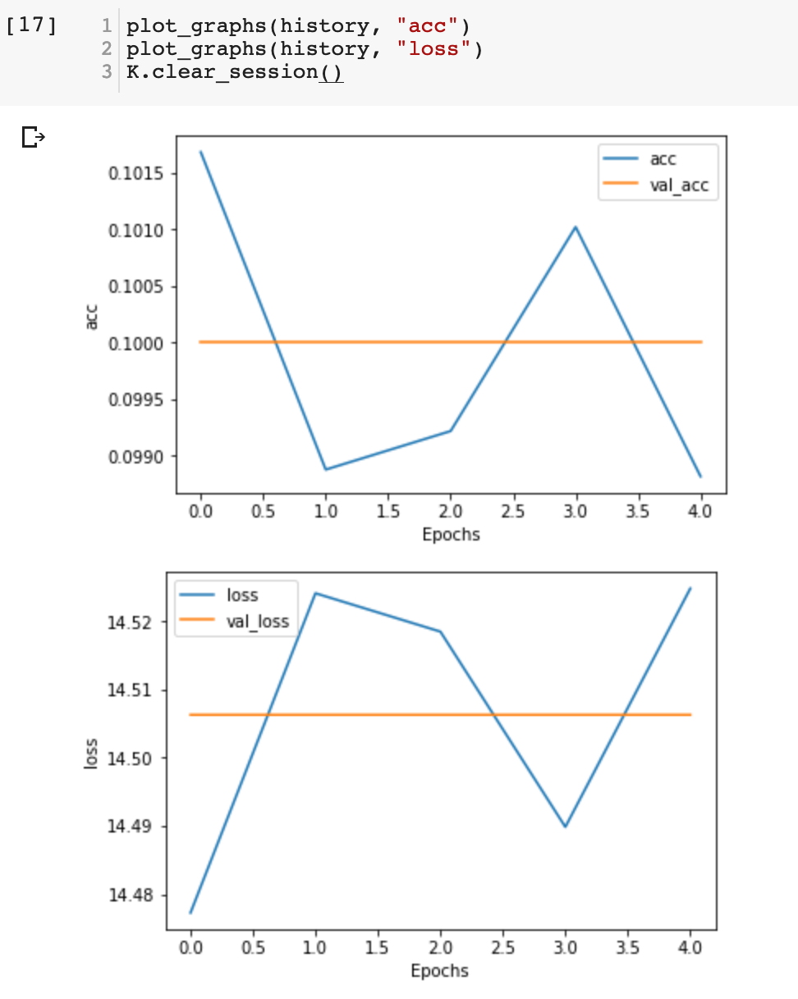
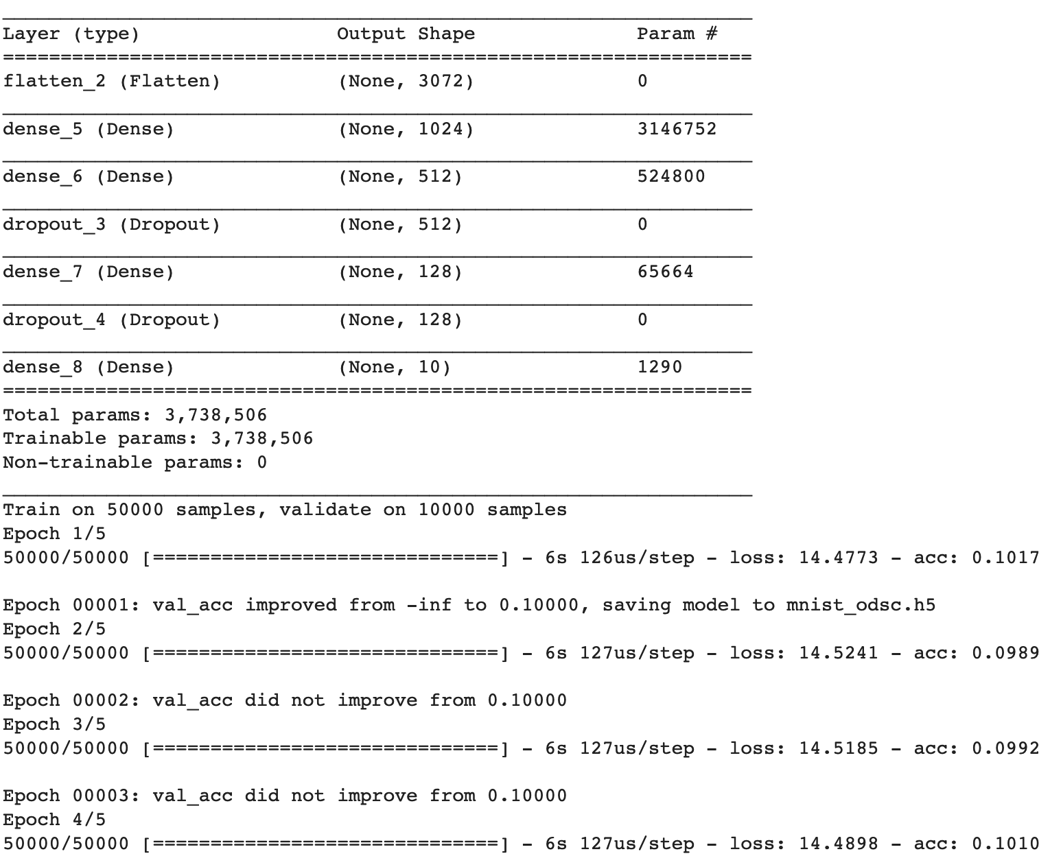

Slide 31
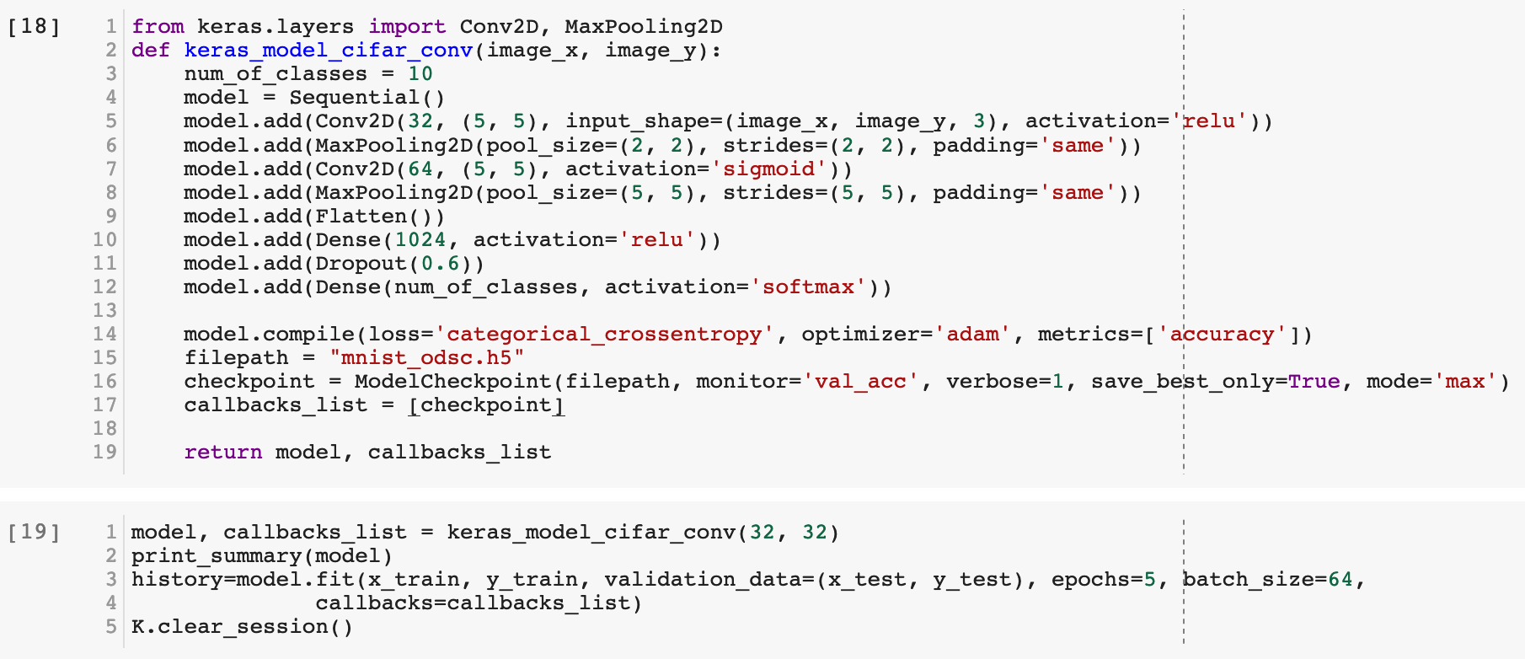
CNN Architecture
Notes:
RMSprop

Slide 32
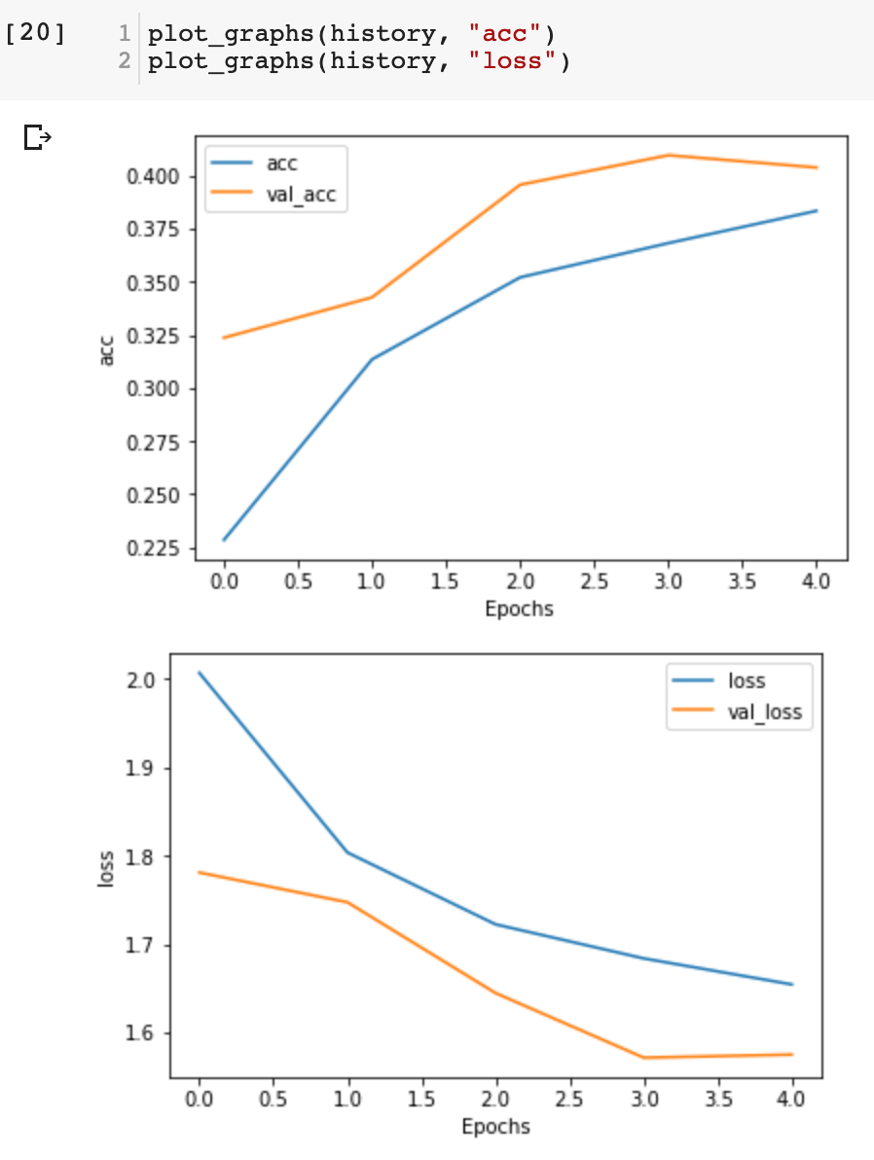
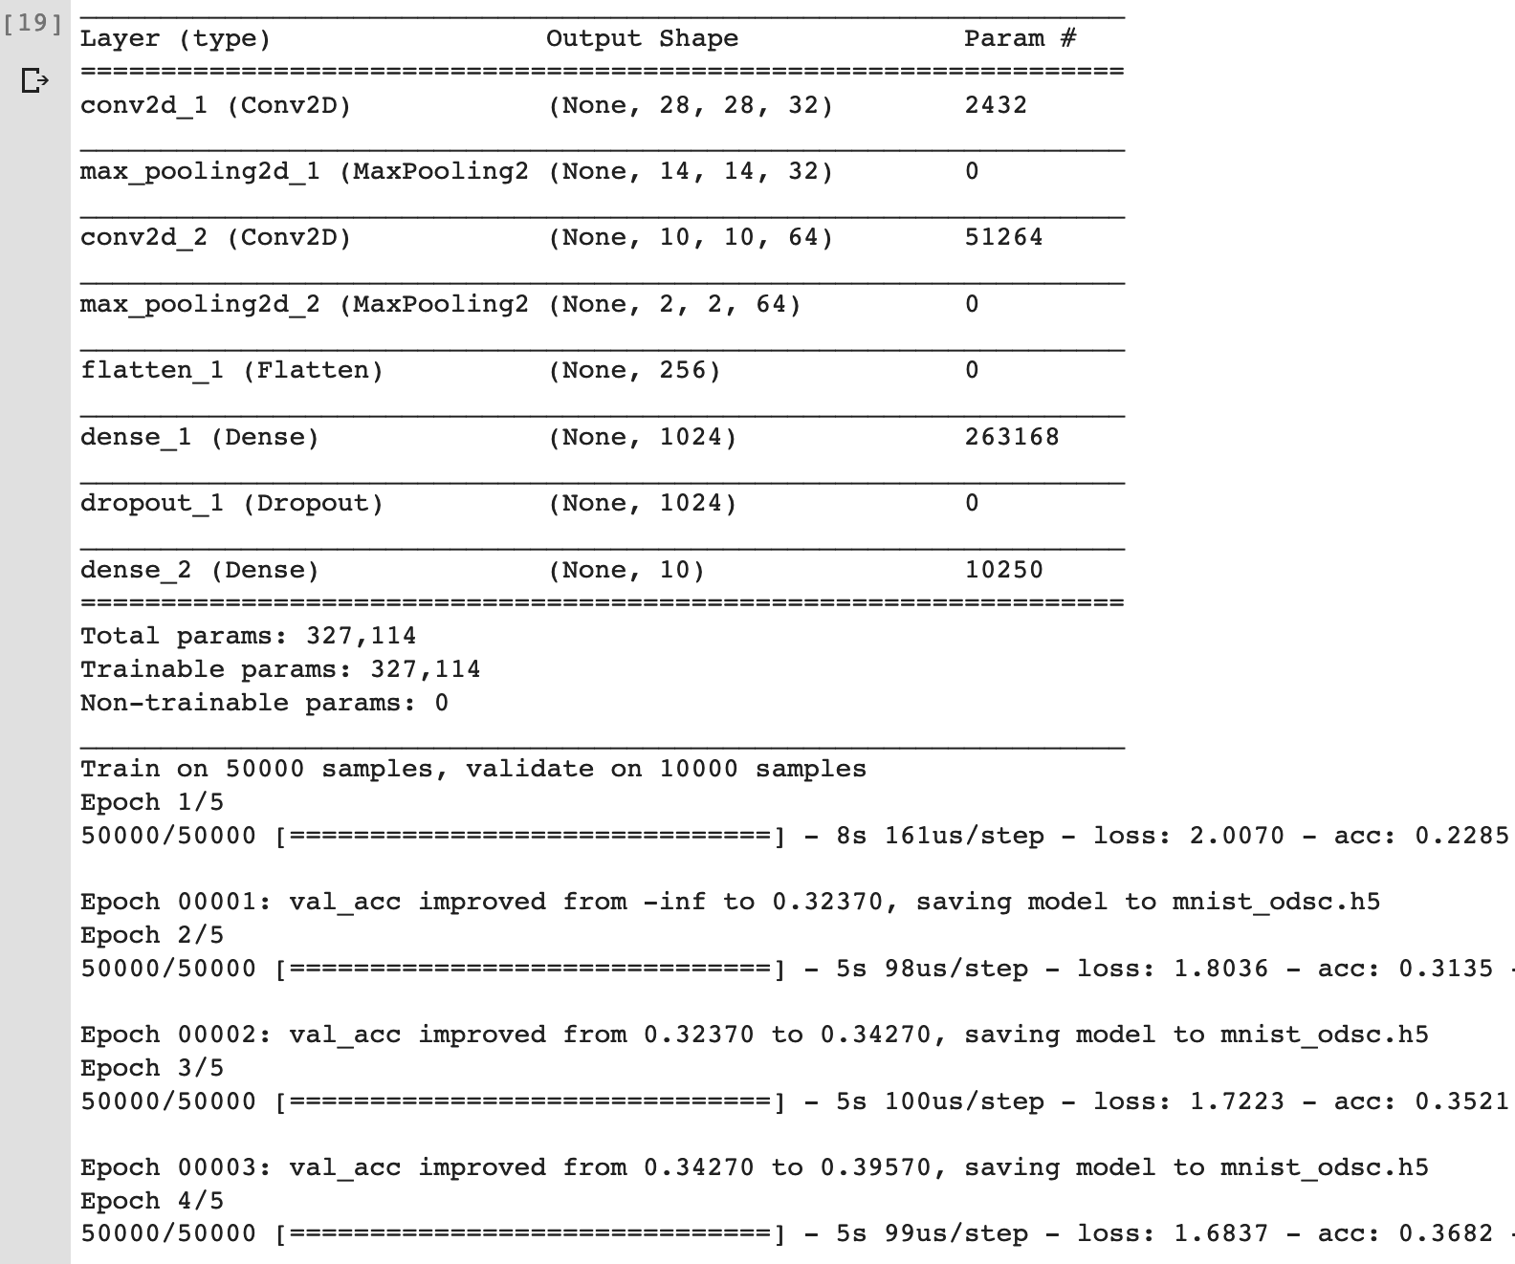

Slide 33
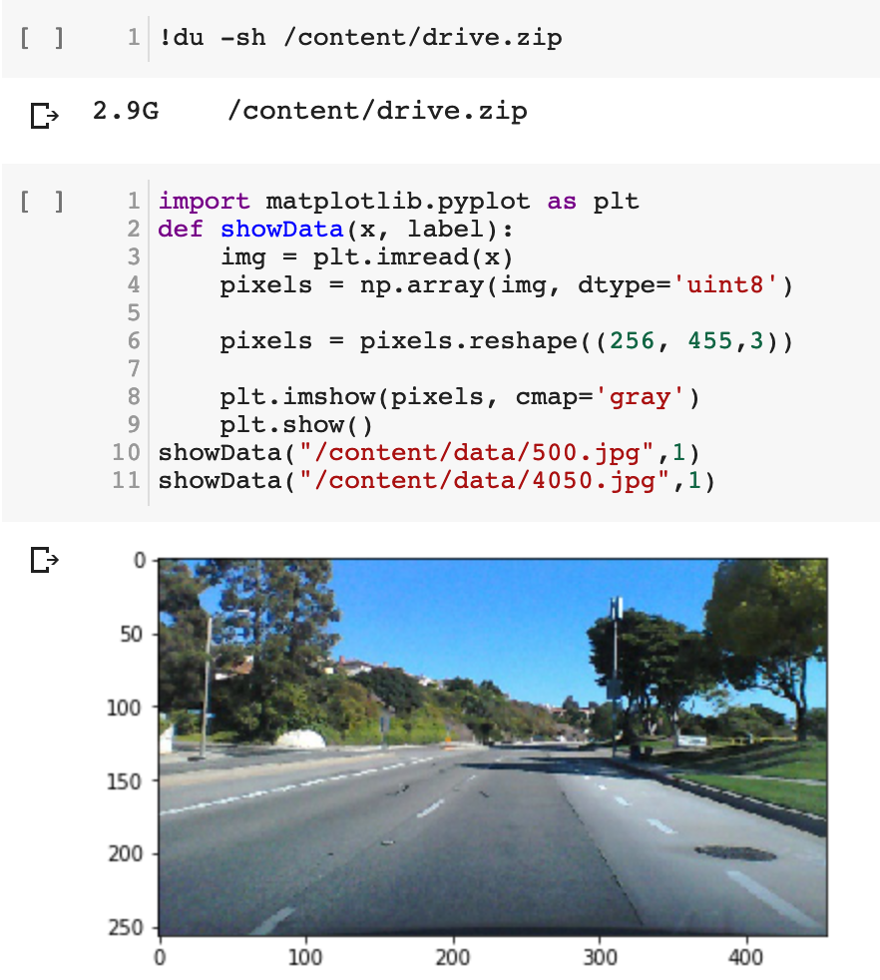
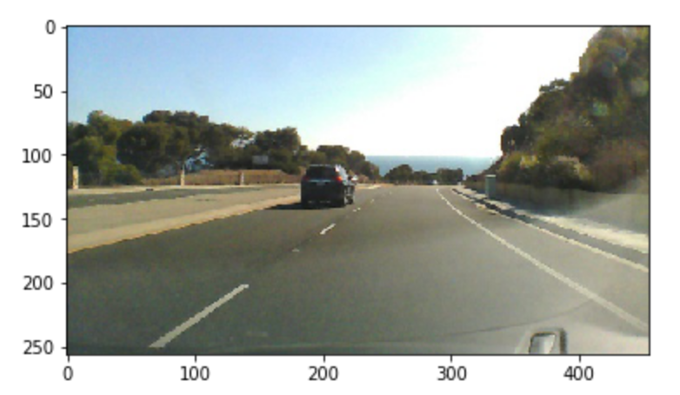
Autopilot research paper by NVIDIA

Slide 34
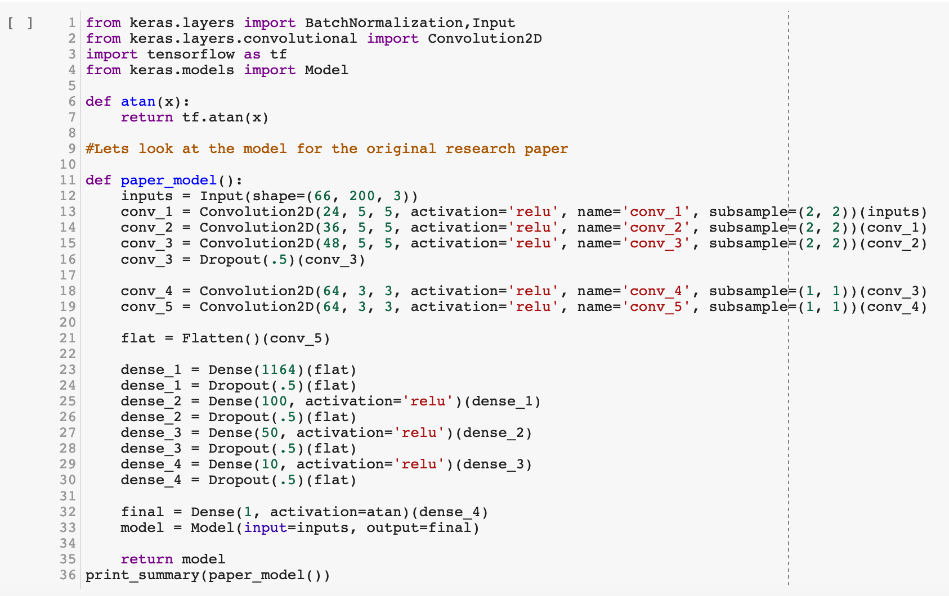

Slide 35
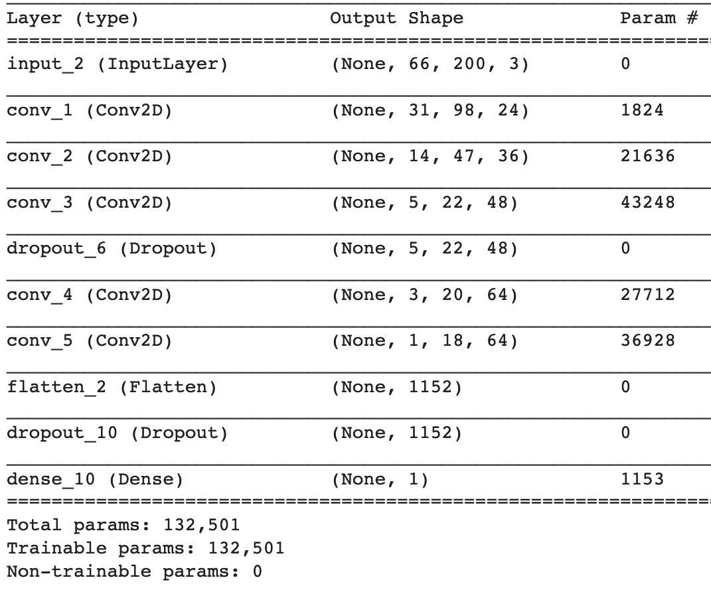
Total pixels per image = 66*200*3
= 39,600

Slide 36
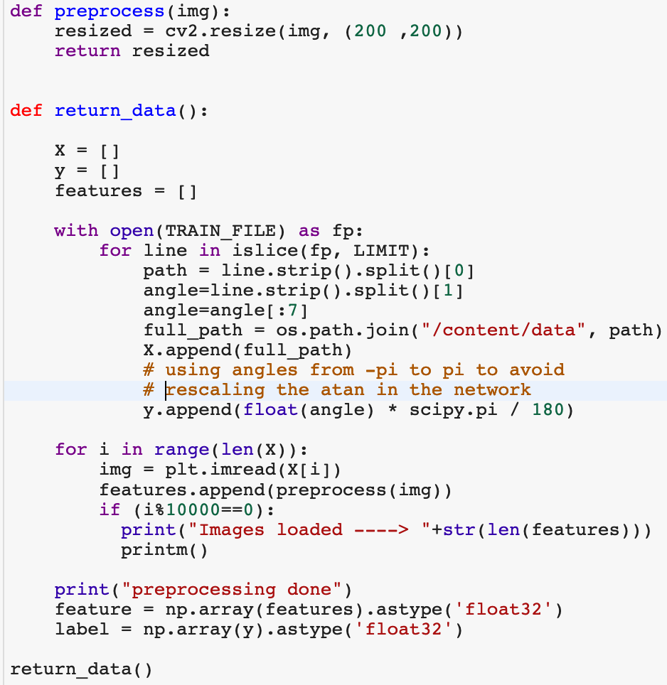
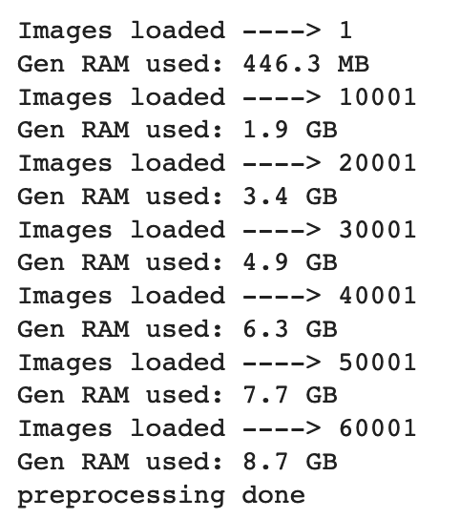

Slide 37
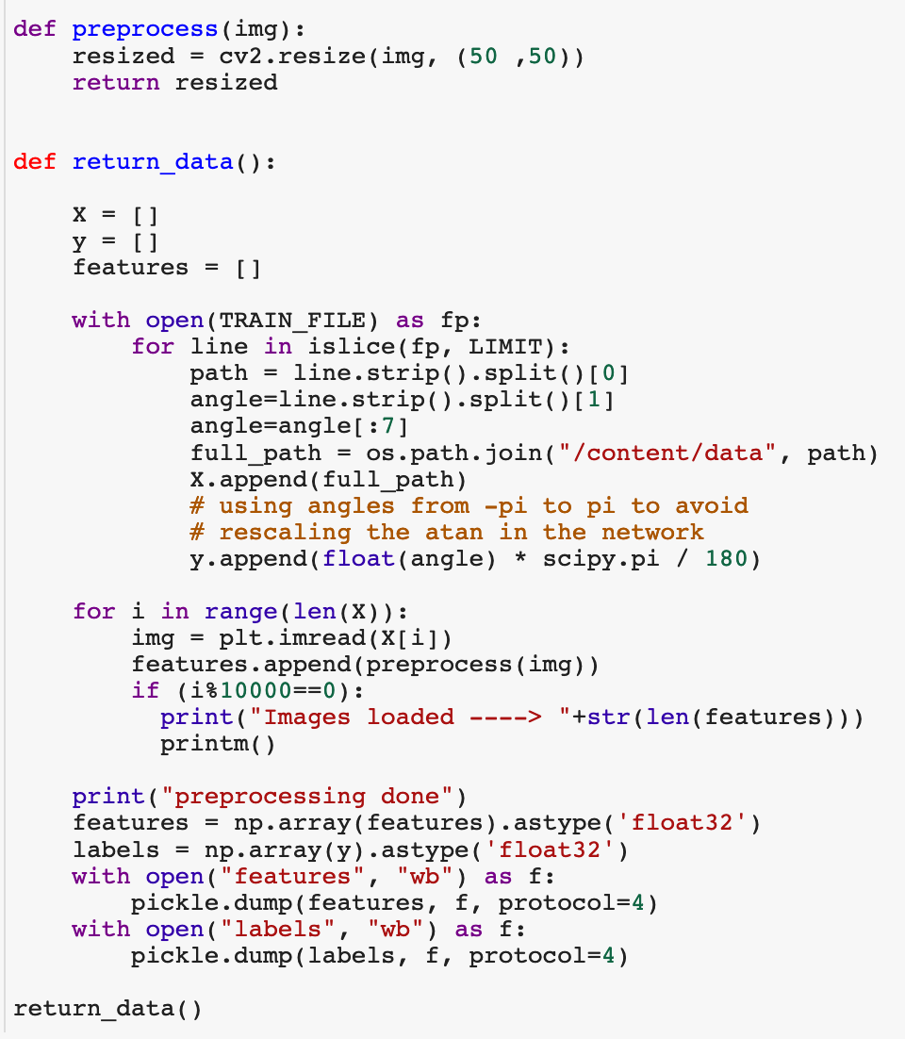
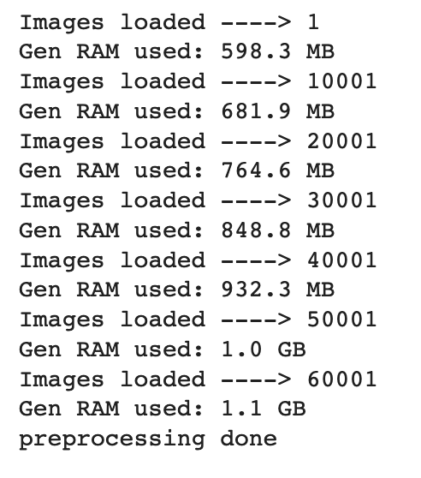
Handling out of memory issue
Scaling
Notes:
RMSprop

Slide 38
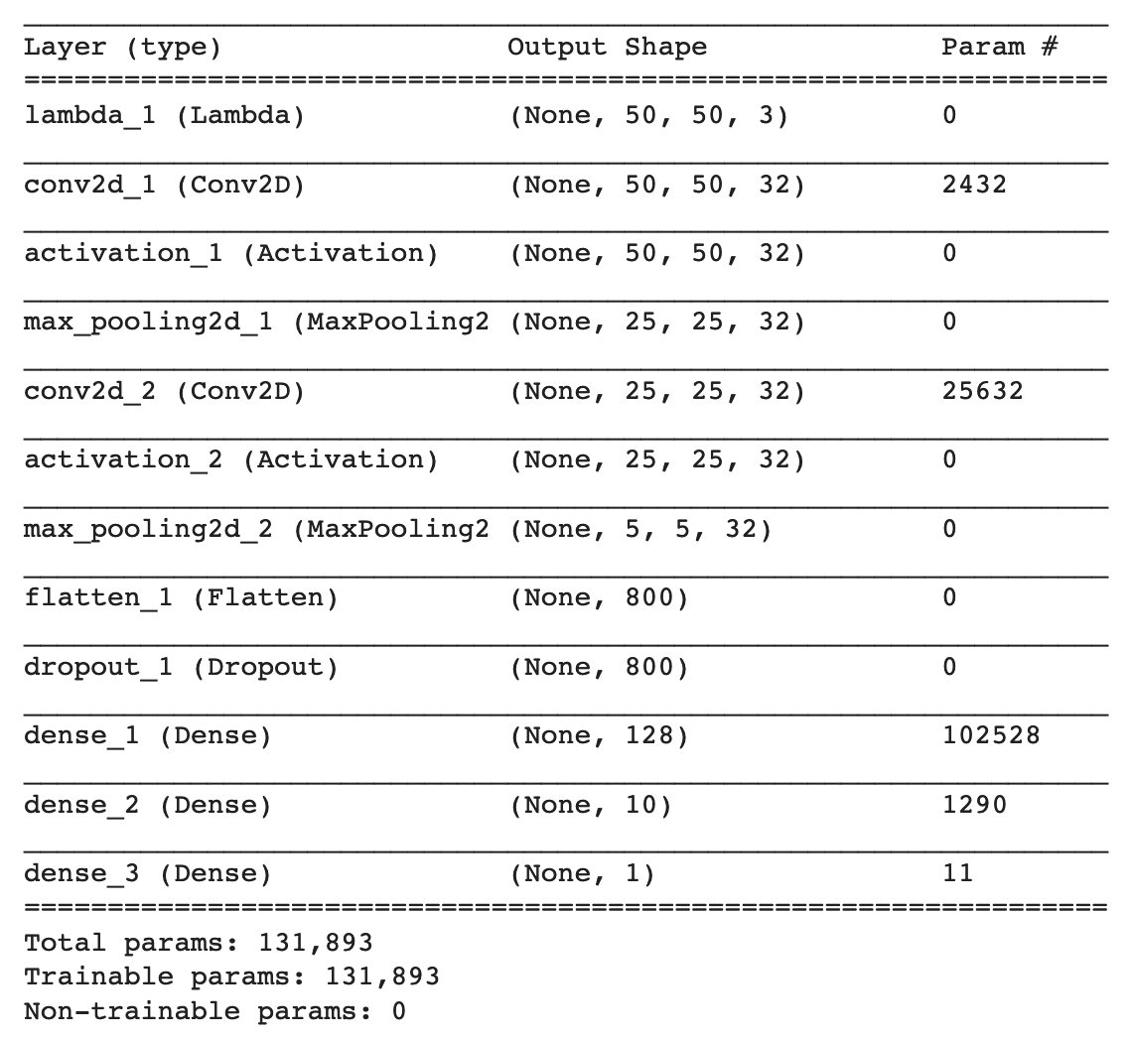
Total pixels per image = 50*50*3
= 7500

Slide 39
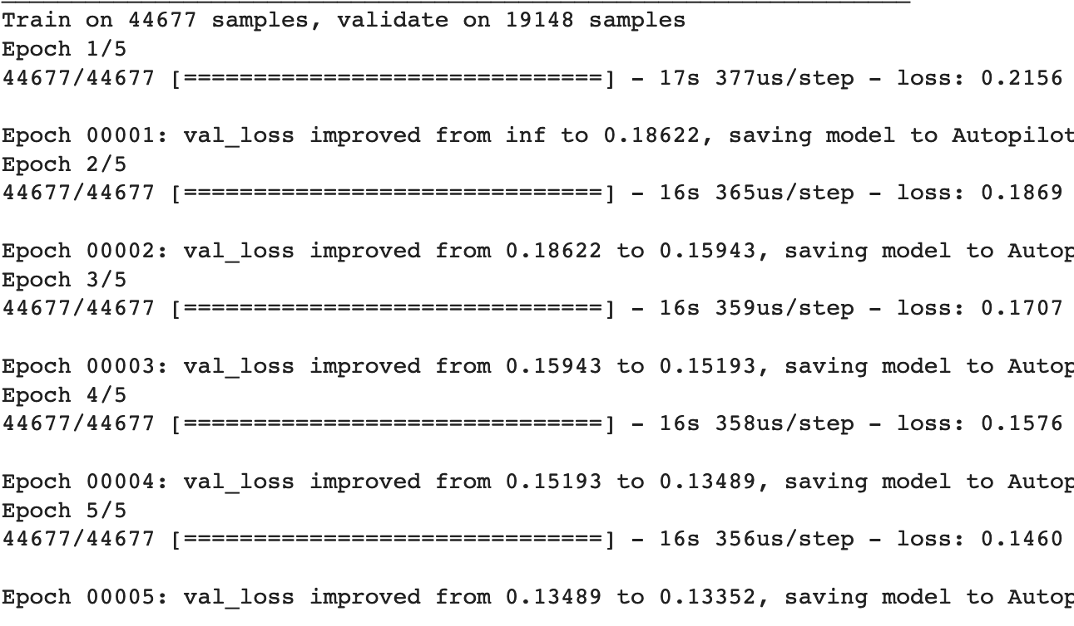
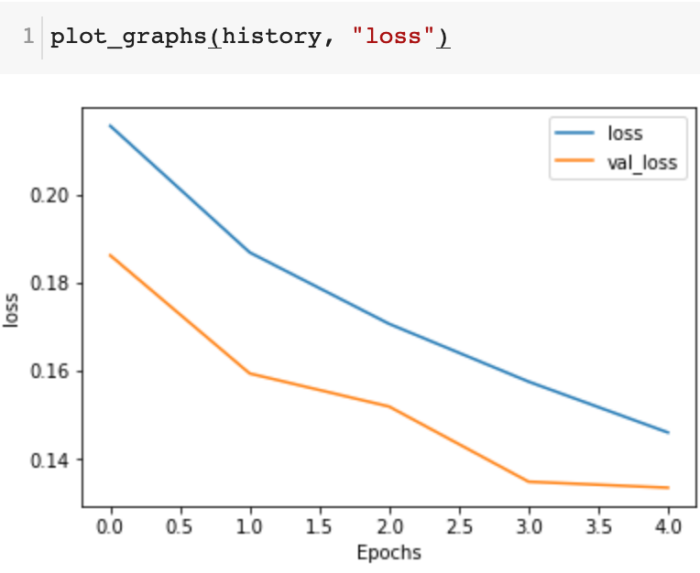

Slide 40
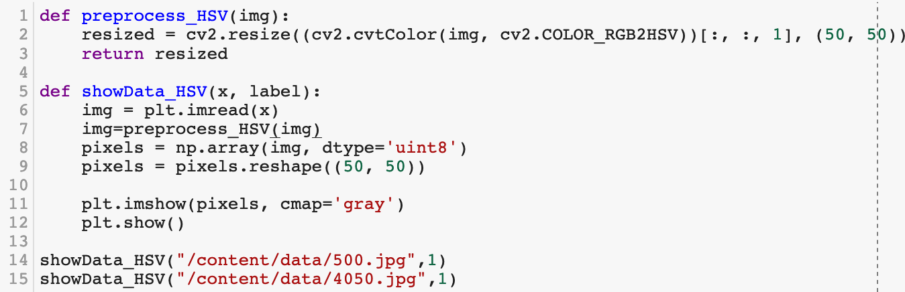
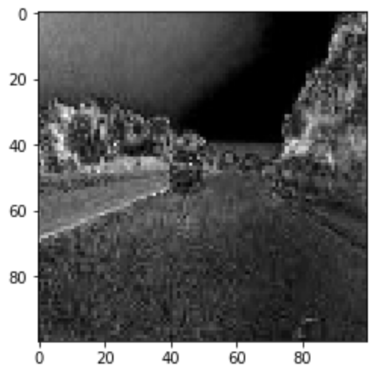
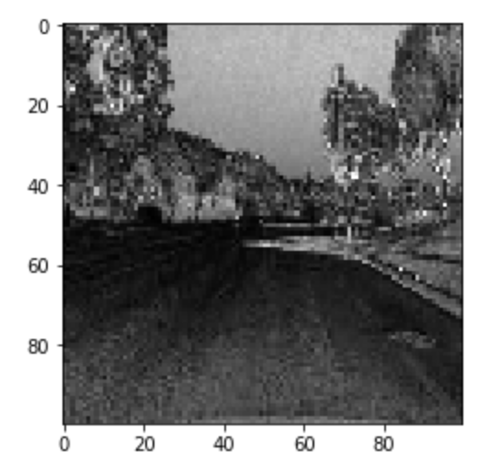
Filtering
Notes:
RMSprop

Slide 41
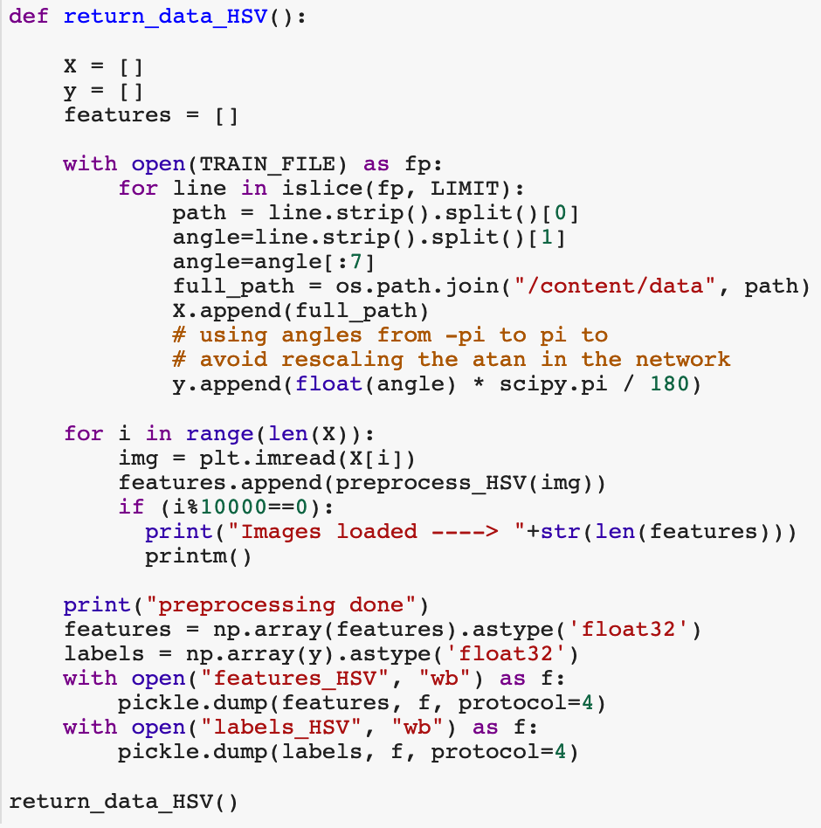
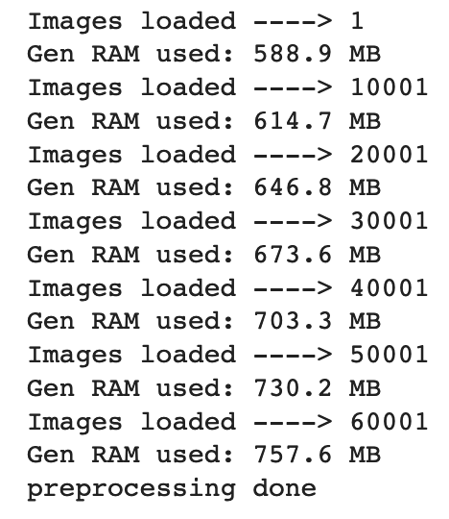

Slide 42

Total pixels per image = 50*50
= 2500

Slide 43



Slide 44

Using fit_generator
Notes:
RMSprop

Slide 45


Total pixels per image = 200*200*3
= 120,000

Slide 46



Slide 47
Autopilot V2

Slide 48



Emojinator
Image generator for Data Augmentation

Slide 49




Slide 50










Slide 51




Slide 52
Emojinator

Slide 53
Rock + Paper+ Scissors

Slide 54





Malaria Detection

Slide 55



Filtering
Notes:
RMSprop

Slide 56


Filtering
Notes:
RMSprop

Slide 57
DeepSign

Slide 58

Let’s address those problems – Q/A

Slide 59


